Slide 1
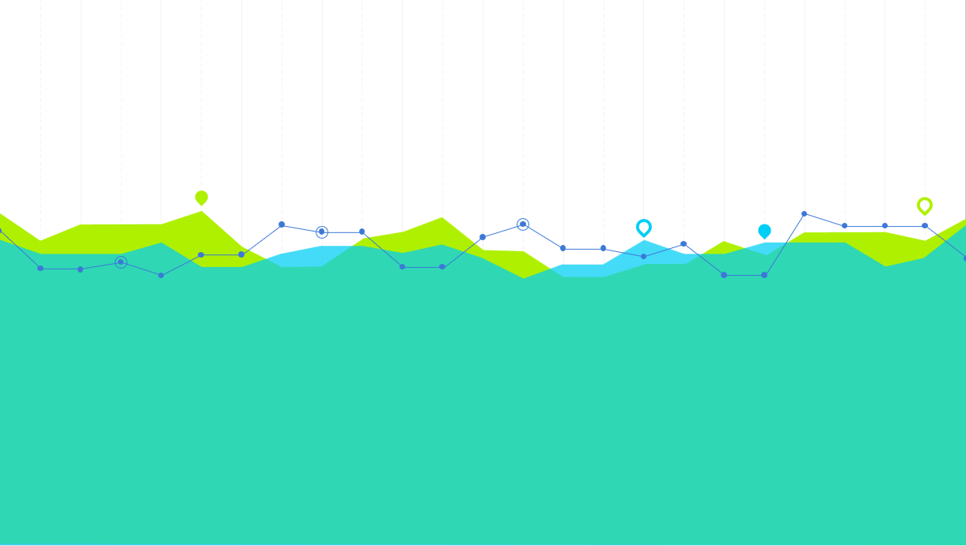
ME205 PROJECT
Analysis of variation of acceleration, velocity and energy with time of a Bouncing ball
GROUP N
Prem Pyari Satsangi (2020MEB1303)
Ranjeet Bahadur (2020MEB1308)
Sehajpreet Singh (2020MEB1314) Spraha Singh (2020MEB1316)
Tushar Sharma (2020MEB1324)

Slide 2
Group description and Contributions
PREM PYARI SATSANGI: THEORY AND PHYSICS BEHIND WHY BALL STOPS BOUNCING
RANJEET BAHADUR: THEORETICAL AND EXPERIMENTAL ANALYSIS
SEHAJPREET SINGH: CAD MODEL, 3D-PRINTED PARTS, ARDUINO PROGAMME,ASSEMBLY
SPRAHA SINGH: ALGODOO SIMULATIONS AND PPT
TUSHAR SHARMA: CAD MODEL, 3D-PRINTED PARTS, ARDUINO PROGAMME,ASSEMBLY

Slide 3
INTRODUCTION
The physics of a bouncing ball concerns the physical behavior of bouncing balls , particularly its motion before, during, and after impact against the surface of another body. The motion of a ball is generally described by projectile motion (which can be affected by gravity, drag, the Magnus effect, and buoyancy), while its impact is usually characterized through the coefficient of restitution(which can be affected by the nature of the ball, the nature of the impacting surface, the impact velocity, rotation, and local conditions such as temperature and pressure).

Slide 4
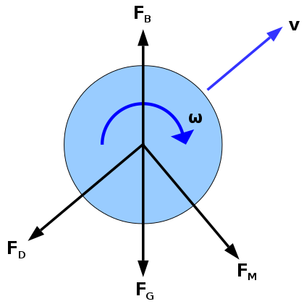
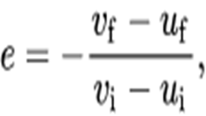
THEORY
Forces during flight and effect on motion
Gravitational Force
Drag Force
Magnus Force
Buoyant Force
Impact
When a ball impacts a surface, the surface recoils and vibrates, as does the ball, creating both sound and heat, and the ball loses kinetic energy. Additionally, the impact can impart some rotation to the ball, transferring some of its translational kinetic energy into rotational kinetic energy. This energy loss is usually characterized (indirectly) through the coefficient of restitution (or COR, denoted e):

Slide 5
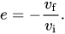
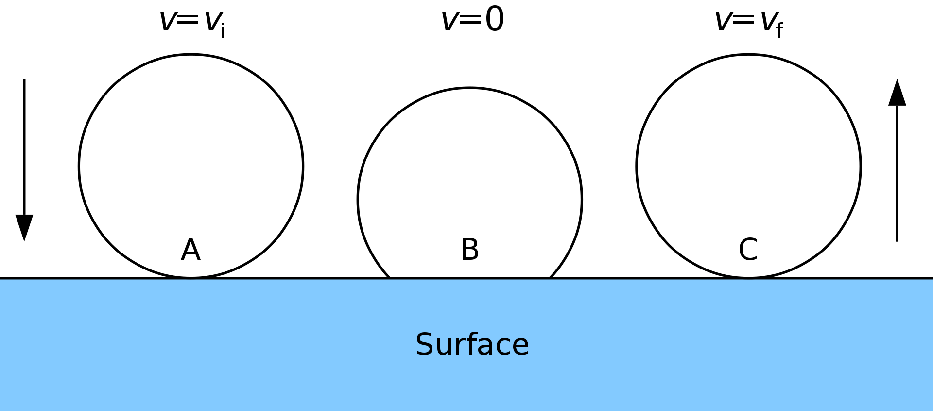
where vf and vi are the final and initial velocities of the ball, and uf and ui are the final and initial velocities impacting surface, respectively. In the specific case where a ball impacts on an immovable surface, the COR simplifies The COR of a ball can be affected by several things, mainly 1. the nature of the impacting surface (e.g. grass, concrete, wire mesh) 2. the material of the ball (e.g. leather, rubber, plastic) 3. the pressure inside the ball (if hollow) 4. the amount of rotation induced in the ball at impact the impact velocity
Zeno’s paradox:- Lets say that the ball bounces half the distance in second bounce irrespective of height neglecting the air resistance and minor losses, this will result in ball bouncing one-fourth time of original height in third bounce, by this phenomenon the ball should be bouncing infinite number of bounces, but in our simulations and physical tests the ball was bouncing a maximum number of 3 bounces. For the counter of this phenomenon we are found out some factors that why the ball does not bunce infinite number of times and bounces for finite number of times.

Slide 6
Initially, the ball would spend most of its time in free fall, approximating the Zeno behavior already described. However, once the bounce energy diminishes to below the "escape energy" of the floor, it is no longer sufficient to raise the ball's center of mass above its natural radius, so the ball no longer looses contact with the ground, but simply bobs up and down in the center-of-mass sense. During this time, we believe the system exhibits dynamic behavior, like a mass sitting on a spring, since the corrective force is now proportional to displacement in the ball center of mass equilibrium.
Now any system (like a pendulum or a mass sitting on a spring) never stops oscillating because its period converges to some non-zero constant. It just swings less and less, but it never stops swinging. So it is with the ball. The "bobbing" decays exponentially over an infinite amount of time or until other disturbances such as impacts from air molecules drown out motion. In our case happens pretty fast as the ball loses energy very quickly.

Slide 7
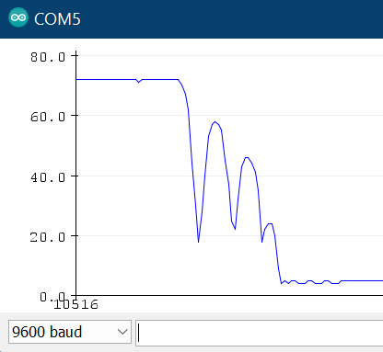
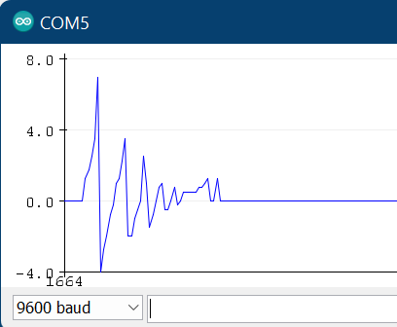

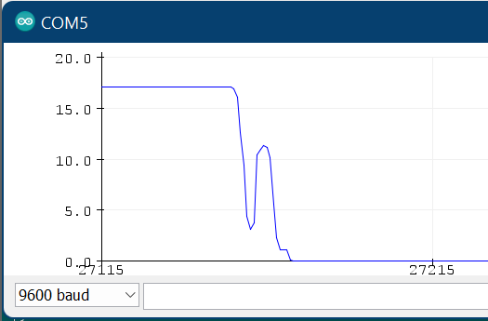
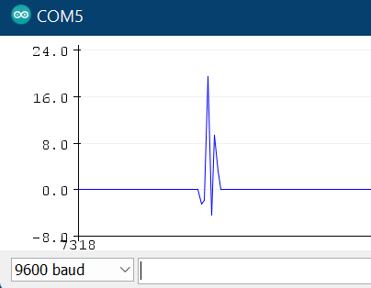
Algoodo Simulations The ball (e=0.62 and m=21g) is dropped from a certain height. Air friction and buoyancy are also taken into account.
Height graph from Sharp sensor
Height graph from Sharp sensor
Energy graph from Sharp sensor
Acceleration graph from Sharp sensor

Slide 8
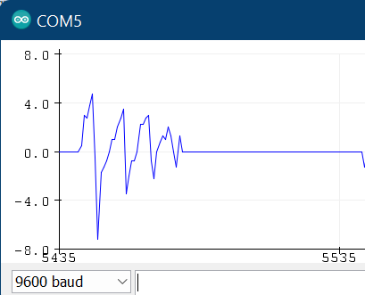

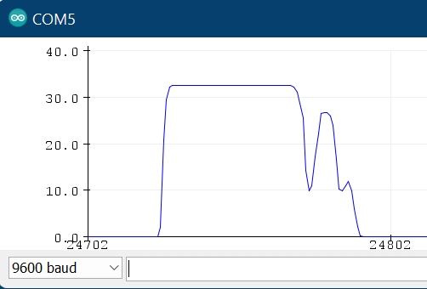
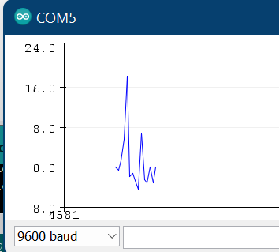
The ball (e=0.81 and m=40g) is dropped from a certain height. Air friction and buoyancy are also taken into account.
Height graph from Sharp sensor
Height graph from Sharp sensor
Energy graph from Sharp sensor
Acceleration graph from Sharp sensor

Slide 9
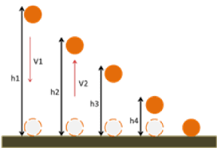
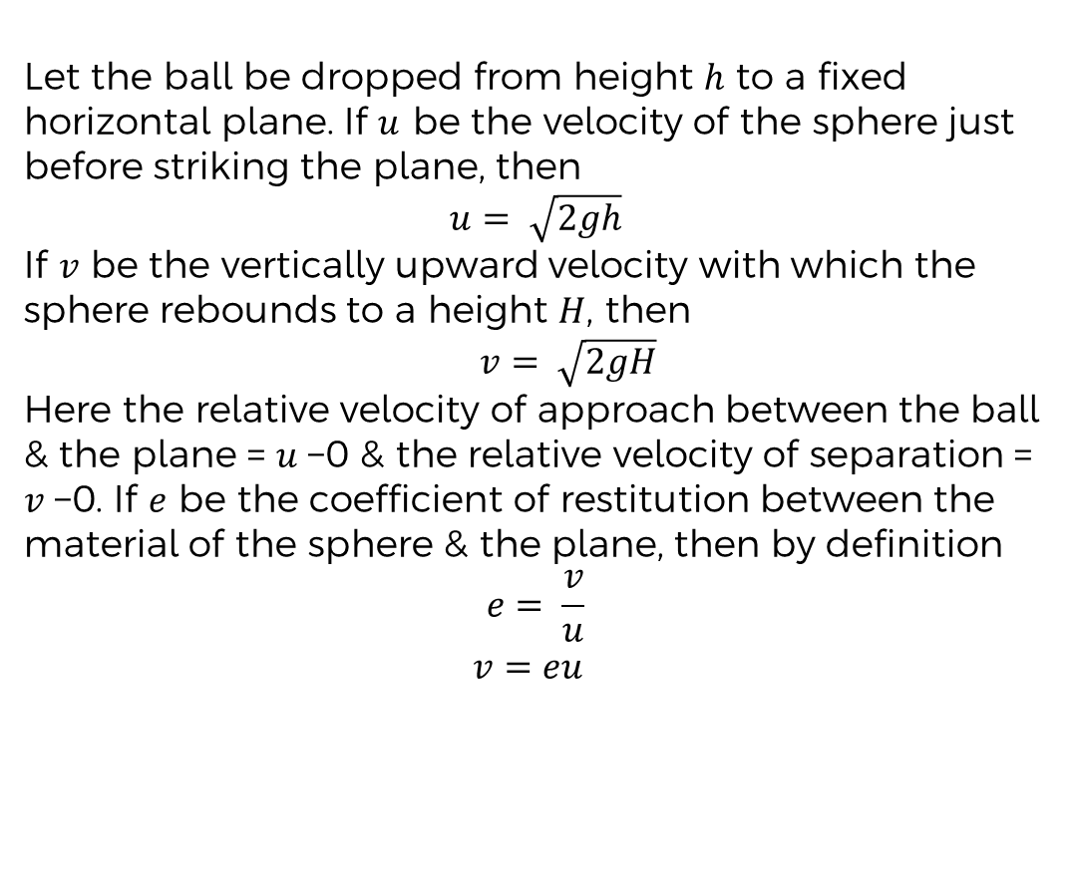
Theoretical Analysis Considering only effects of Gravitational force.
Let the ball be dropped from height $h$ to a fixed horizontal plane. If $u$ be the velocity of the sphere just before striking the plane, then
$$u= \sqrt{2gh}$$ If $v$ be the vertically upward velocity with which the sphere rebounds to a height $H$, then $v= \sqrt{2gH}$
Here the relative velocity of approach between the ball & the plane = $u$−0 & the relative velocity of separation = $v$−0. If $e$ be the coefficient of restitution between the material of the sphere & the plane, then by definition $$e= \frac{v}{u}$$
$v=eu$

Slide 10
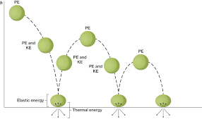
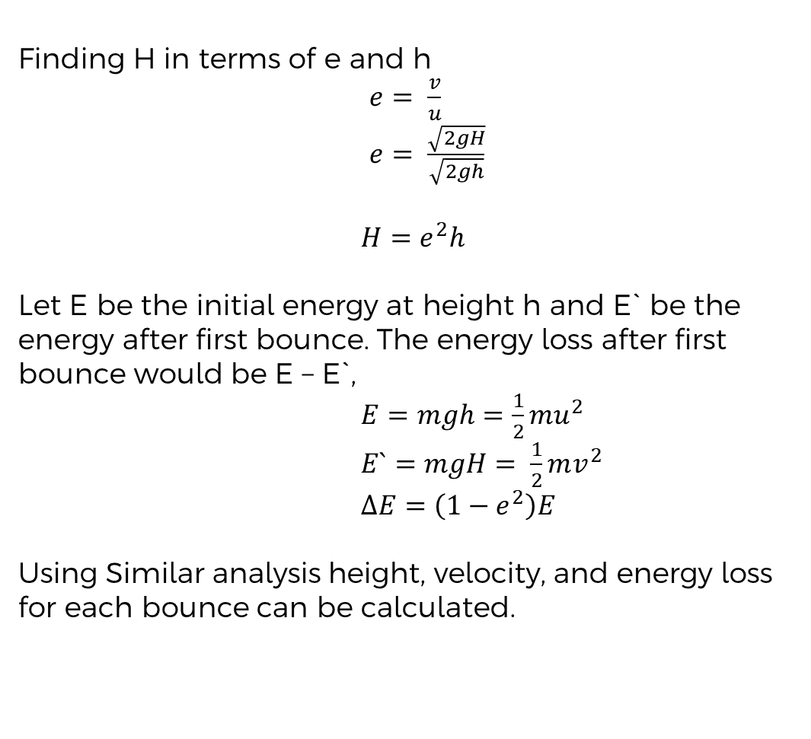
Theoretical Analysis Considering only effects of Gravitational force.
Finding H in terms of e and h
$e= \frac{v}{u}$
$e= \frac{\sqrt{2gH}}{\sqrt{2gh}}$
$H=e^{2}h$
Let E be the initial energy at height h and E` be the energy after first bounce. The energy loss after first bounce would be E – E`,
$E=mgh=\frac{1}{2}mu^{2}$
$E`=mgH= \frac{1}{2}mv^{2}$
$ΔE=\left(1−e^{2}\right)E$
Using Similar analysis height, velocity, and energy loss for each bounce can be calculated.

Slide 11
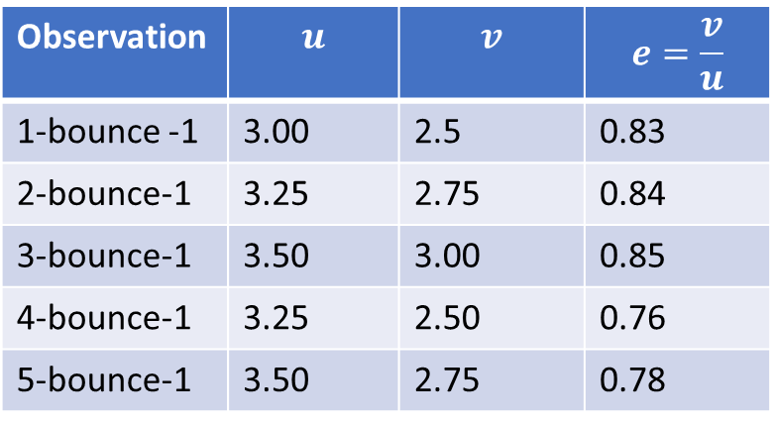

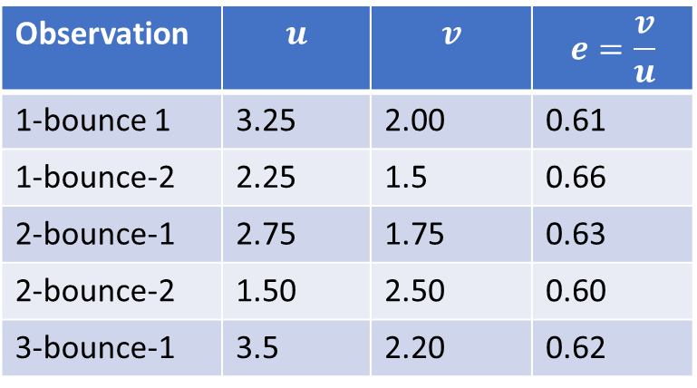

Experimental Analysis Error analysis
Value of e for tennis ball and sponge ball on wood surface:
Observation | $$u$$ | $$v$$ | $$e=\frac{v}{u}$$
1-bounce -1 | 3.00 | 2.5 | 0.83
2-bounce-1 | 3.25 | 2.75 | 0.84
3-bounce-1 | 3.50 | 3.00 | 0.85
4-bounce-1 | 3.25 | 2.50 | 0.76
5-bounce-1 | 3.50 | 2.75 | 0.78
Observation | $$u$$ | $$v$$ | $$e=\frac{v}{u}$$
1-bounce 1 | 3.25 | 2.00 | 0.61
1-bounce-2 | 2.25 | 1.5 | 0.66
2-bounce-1 | 2.75 | 1.75 | 0.63
2-bounce-2 | 1.50 | 2.50 | 0.60
3-bounce-1 | 3.5 | 2.20 | 0.62
Average value of e:
$$e_{tennis} =0.81$$
Average value of e:
$$e_{sponge}=0.62$$

Slide 12
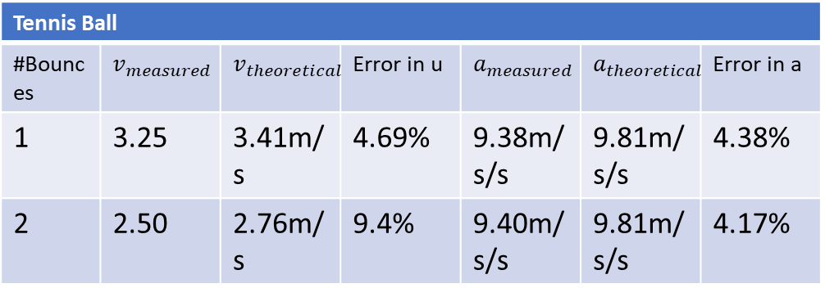
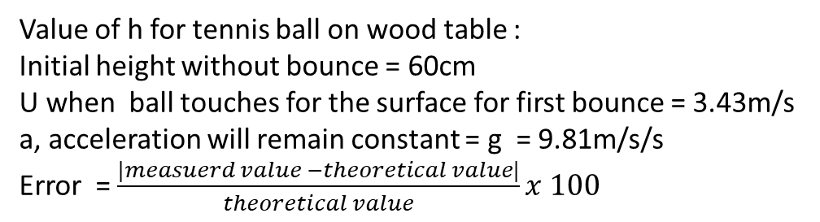
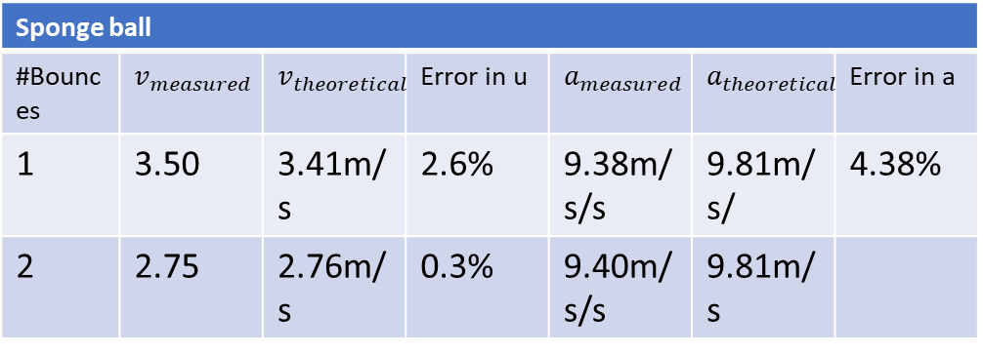
Experimental Analysis Error analysis
Value of h for tennis ball on wood table :
Initial height without bounce = 60cm
U when ball touches for the surface for first bounce = 3.43m/s
a, acceleration will remain constant = g = 9.81m/s/s
Error = $\frac{|measuerd value −theoretical value|}{theoretical value}x 100$
Tennis Ball
#Bounces | $$v_{measured}$$ | $$v_{theoretical}$$ | Error in u | $$a_{measured}$$ | $$a_{theoretical}$$ | Error in a
1 | 3.25 | 3.41m/s | 4.69% | 9.38m/s/s | 9.81m/s/s | 4.38%
2 | 2.50 | 2.76m/s | 9.4% | 9.40m/s/s | 9.81m/s/s | 4.17%
Tennis Ball
Bounce | Total Energy | Total energy(exp) | Error
0 | 0.21 J | 0.21 J | 0%
1 | 0.14 J | 0.15 J | 7%
Sponge ball
#Bounces | $$v_{measured}$$ | $$v_{theoretical}$$ | Error in u | $$a_{measured}$$ | $$a_{theoretical}$$ | Error in a
1 | 3.50 | 3.41m/s | 2.6% | 9.38m/s/s | 9.81m/s/ | 4.38%
2 | 2.75 | 2.76m/s | 0.3% | 9.40m/s/s | 9.81m/s
Sponge Ball
Bounce | Total Energy | Total energy(exp) | Error
0 | 011 J | 0.11 J | 0%
1 | 0.0400 J | 0.03 J | 25%

Slide 13
Acknowledgement
We would like to express our special tanks of gratitude to our professors who gave us the golden opportunity to do this wonderful project on this topic, which helped us in doing a lot of practical work and we came to know about so many new things
Thank you

